Slide 1
Artificial Neural Networks
Torsten Reil
torsten.reil@zoo.ox.ac.uk

Slide 2
Outline
What are Neural Networks?
Biological Neural Networks
ANN – The basics
Feed forward net
Training
Example – Voice recognition
Applications – Feed forward nets
Recurrency
Elman nets
Hopfield nets
Central Pattern Generators
Conclusion

Slide 3
What are Neural Networks?
Models of the brain and nervous system
Highly parallel
  Process information much more like the brain than a serial computer
Learning
Very simple principles
Very complex behaviours
Applications
  As powerful problem solvers
  As biological models

Slide 4
Biological Neural Nets
Pigeons as art experts (Watanabe et al. 1995)
  Experiment:
    Pigeon in Skinner box
    Present paintings of two different artists (e.g. Chagall / Van Gogh)
    Reward for pecking when presented a particular artist (e.g. Van Gogh)

Slide 5
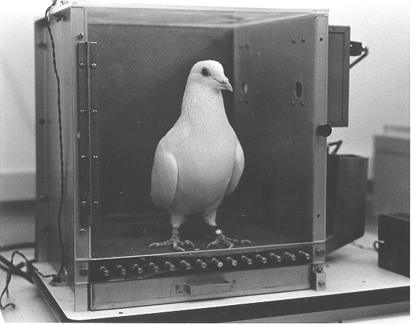

Slide 6
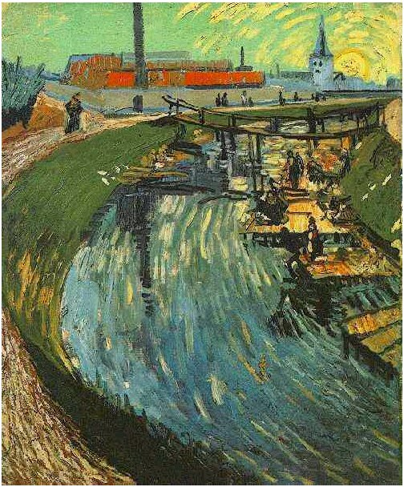
Notes:
Canal with Women Washing, 1888

Slide 7
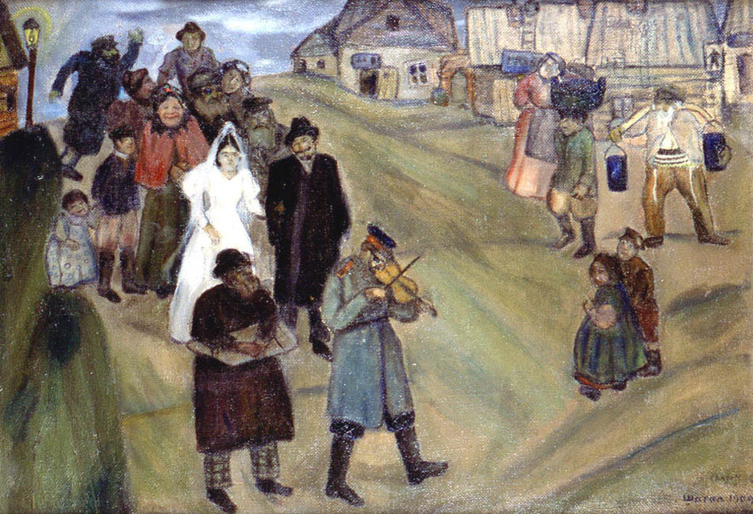

Slide 8
Pigeons were able to discriminate between Van Gogh and Chagall with 95% accuracy (when presented with pictures they had been trained on)
Discrimination still 85% successful for previously unseen paintings of the artists
Pigeons do not simply memorise the pictures
They can extract and recognise patterns (the ‘style’)
They generalise from the already seen to make predictions
This is what neural networks (biological and artificial) are good at (unlike conventional computer)

Slide 9
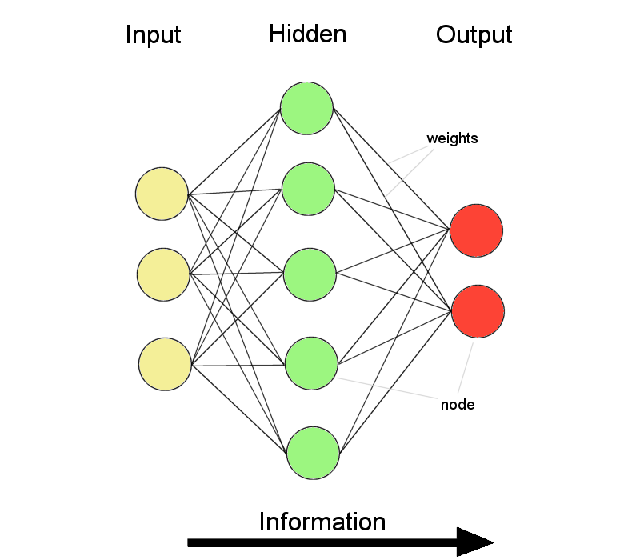
ANNs – The basics
ANNs incorporate the two fundamental components of biological neural nets:
Neurones (nodes)
Synapses (weights)

Slide 10
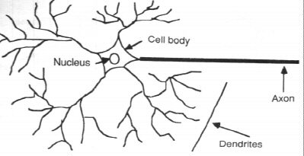
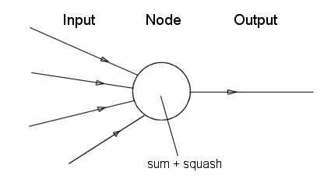
Neurone vs. Node

Slide 11
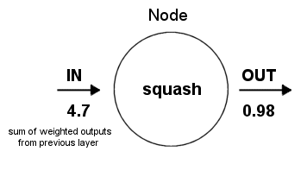
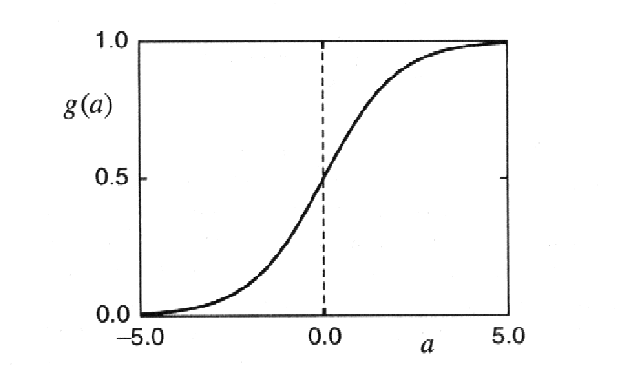
Structure of a node:
Squashing function limits node output:

Slide 12
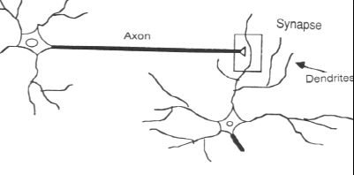
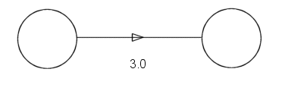
Synapse vs. weight

Slide 13
Feed-forward nets
Information flow is unidirectional
  Data is presented to Input layer
  Passed on to Hidden Layer
  Passed on to Output layer
Information is distributed
Information processing is parallel
Internal representation (interpretation) of data

Slide 14
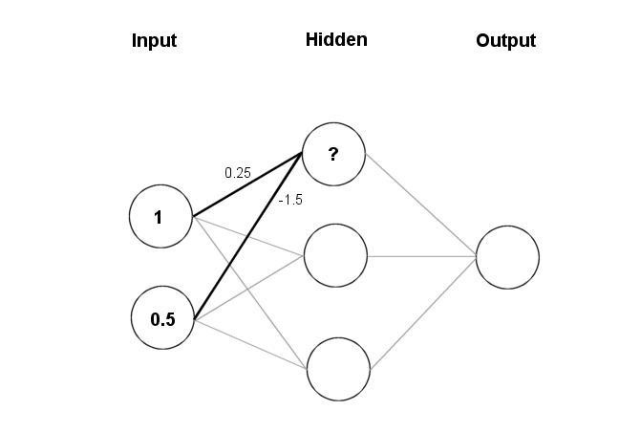
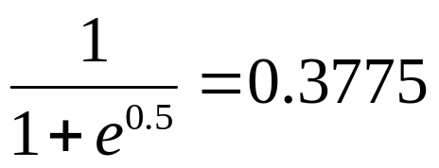
Feeding data through the net:
(1 × 0.25) + (0.5 × (-1.5)) = 0.25 + (-0.75) = - 0.5
Squashing:

Slide 15
Data is presented to the network in the form of activations in the input layer
Examples
  Pixel intensity (for pictures)
  Molecule concentrations (for artificial nose)
  Share prices (for stock market prediction)
Data usually requires preprocessing
  Analogous to senses in biology
How to represent more abstract data, e.g. a name?
  Choose a pattern, e.g.
    0-0-1 for “Chris”
    0-1-0 for “Becky”

Slide 16
Weight settings determine the behaviour of a network
→ How can we find the right weights?

Slide 17
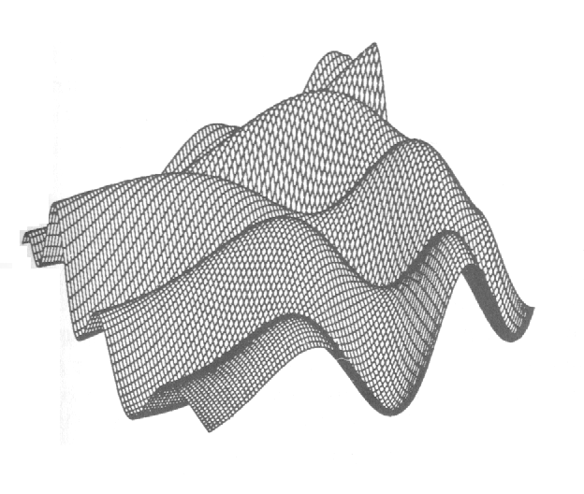
Training the Network - Learning
Backpropagation
  Requires training set (input / output pairs)
  Starts with small random weights
  Error is used to adjust weights (supervised learning)
  → Gradient descent on error landscape

Slide 18
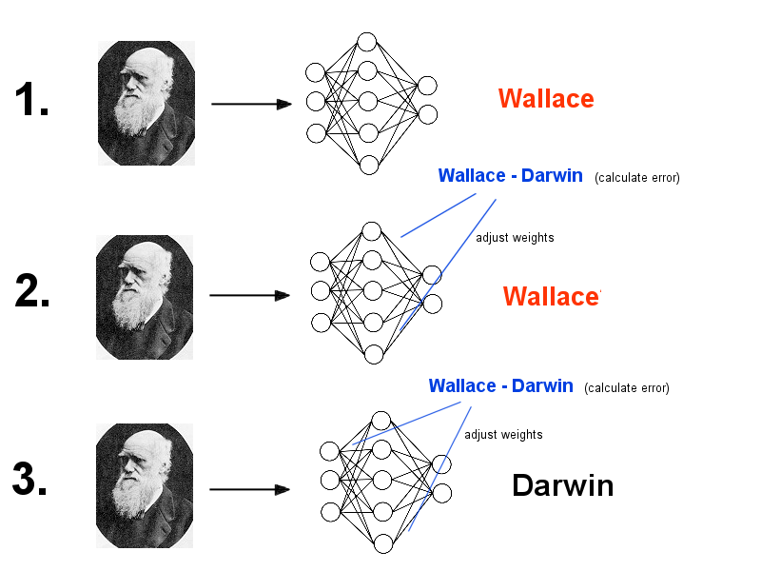

Slide 19
Advantages
  It works!
  Relatively fast
Downsides
  Requires a training set
  Can be slow
  Probably not biologically realistic
Alternatives to Backpropagation
  Hebbian learning
    Not successful in feed-forward nets
  Reinforcement learning
    Only limited success
  Artificial evolution
    More general, but can be even slower than backprop

Slide 20
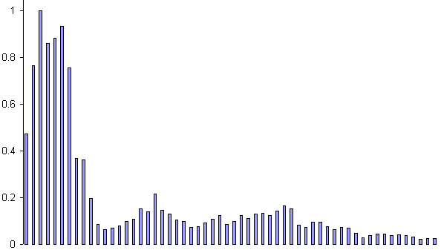
Example: Voice Recognition
Task: Learn to discriminate between two different voices saying “Hello”
Data
  Sources
    Steve Simpson
    David Raubenheimer
  Format
    Frequency distribution (60 bins)
    Analogy: cochlea

Slide 21
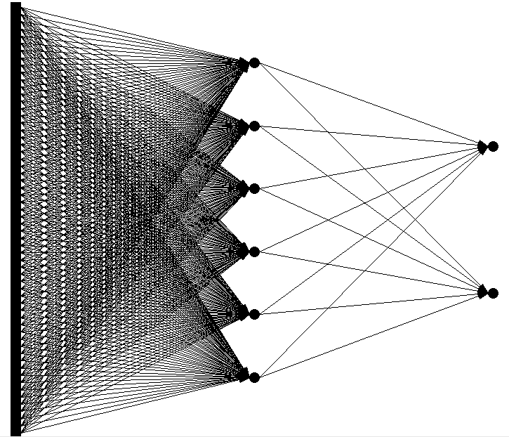
Network architecture
  Feed forward network
    60 input (one for each frequency bin)
    6 hidden
    2 output (0-1 for “Steve”, 1-0 for “David”)

Slide 22
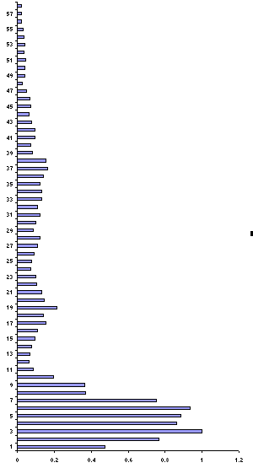
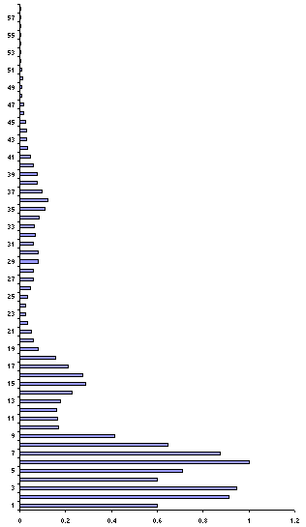
Presenting the data
Steve
David

Slide 23
Presenting the data (untrained network)
Steve
0.43
0.26
David
0.73
0.55

Slide 24
Calculate error
Steve
0.43 – 0 = 0.43
0.26 –1 = 0.74
David
0.73 – 1 = 0.27
0.55 – 0 = 0.55

Slide 25
Backprop error and adjust weights
Steve
0.43 – 0 = 0.43
0.26 – 1 = 0.74
1.17
David
0.73 – 1 = 0.27
0.55 – 0 = 0.55
0.82

Slide 26
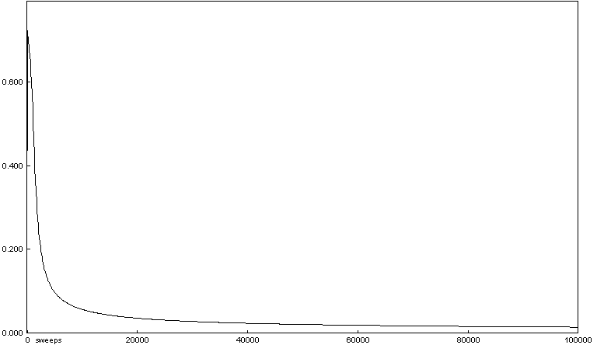
Repeat process (sweep) for all training pairs
  Present data
  Calculate error
  Backpropagate error
  Adjust weights
Repeat process multiple times

Slide 27
Presenting the data (trained network)
Steve
0.01
0.99
David
0.99
0.01

Slide 28
Results – Voice Recognition
  Performance of trained network
    Discrimination accuracy between known “Hello”s
      100%
    Discrimination accuracy between new “Hello”’s
      100%
Demo

Slide 29
Results – Voice Recognition (ctnd.)
  Network has learnt to generalise from original data
  Networks with different weight settings can have same functionality
  Trained networks ‘concentrate’ on lower frequencies
  Network is robust against non-functioning nodes

Slide 30
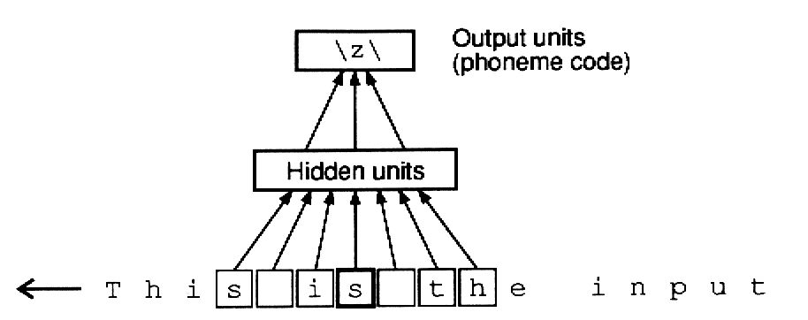
Applications of Feed-forward nets
  Pattern recognition
    Character recognition
    Face Recognition
  Sonar mine/rock recognition (Gorman & Sejnowksi, 1988)
  Navigation of a car (Pomerleau, 1989)
  Stock-market prediction
  Pronunciation (NETtalk)
  (Sejnowksi & Rosenberg, 1987)

Slide 31
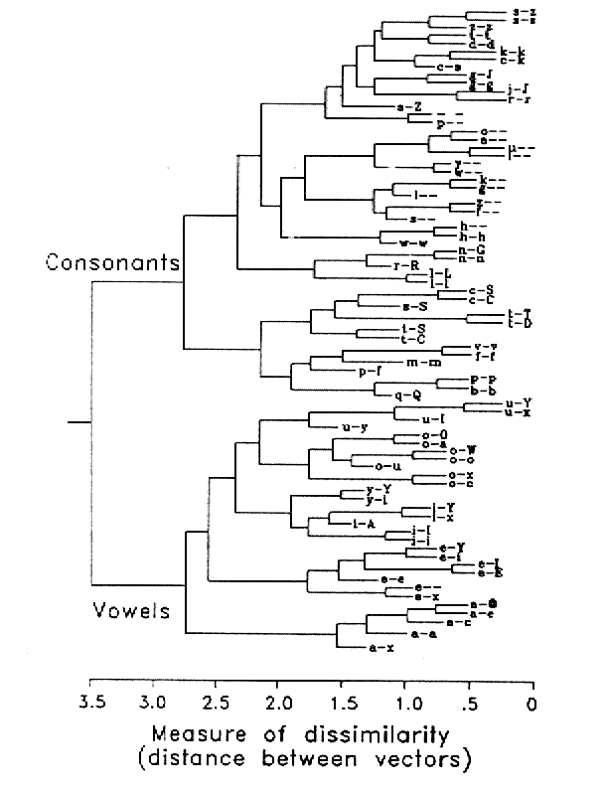
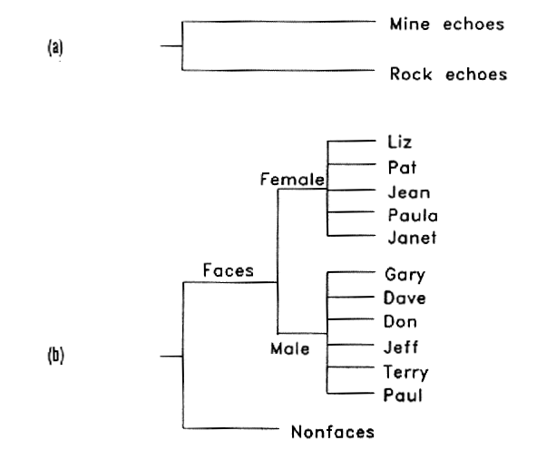
Cluster analysis of hidden layer

Slide 32
FFNs as Biological Modelling Tools
Signalling / Sexual Selection
  Enquist & Arak (1994)
    Preference for symmetry not selection for ‘good genes’, but instead arises through the need to recognise objects irrespective of their orientation
  Johnstone (1994)
    Exaggerated, symmetric ornaments facilitate mate recognition
  (but see Dawkins & Guilford, 1995)

Slide 33
Recurrent Networks
Feed forward networks:
  Information only flows one way
  One input pattern produces one output
  No sense of time (or memory of previous state)
Recurrency
  Nodes connect back to other nodes or themselves
  Information flow is multidirectional
  Sense of time and memory of previous state(s)
Biological nervous systems show high levels of recurrency (but feed-forward structures exists too)

Slide 34
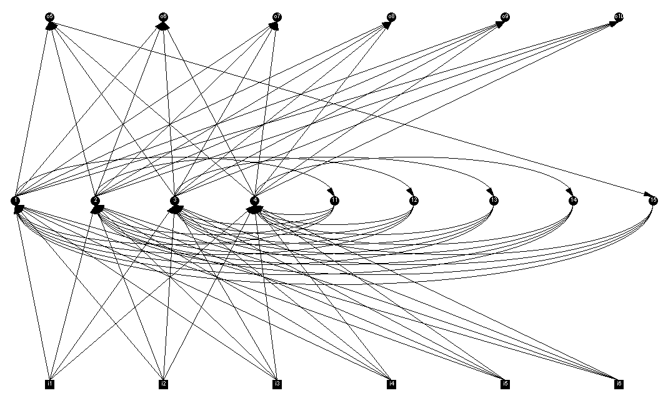
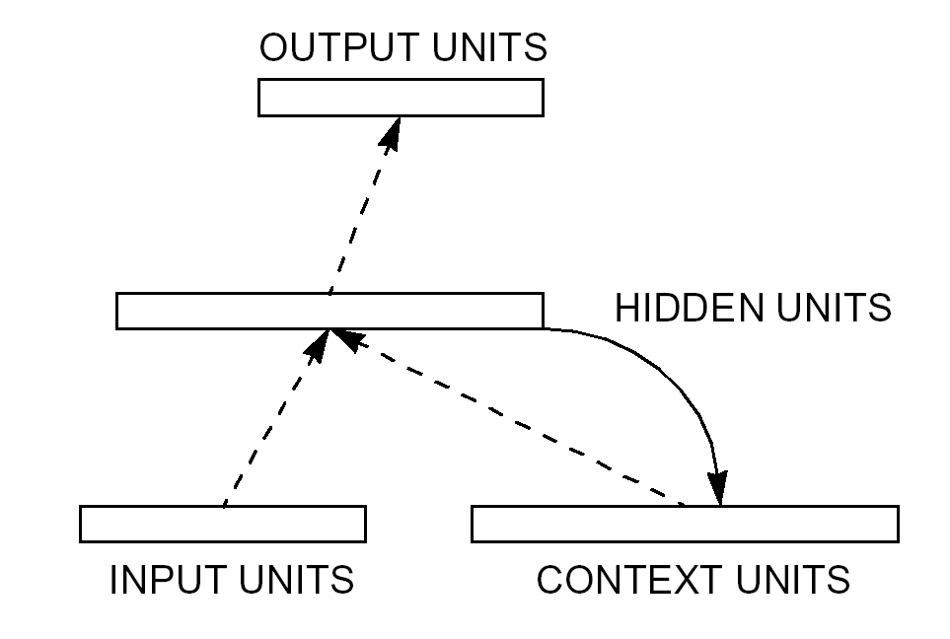
Elman Nets
Elman nets are feed forward networks with partial recurrency
Unlike feed forward nets, Elman nets have a memory or sense of time

Slide 35
Classic experiment on language acquisition and processing (Elman, 1990)
Task
  Elman net to predict successive words in sentences.
Data
  Suite of sentences, e.g.
    “The boy catches the ball.”
    “The girl eats an apple.”
  Words are input one at a time
Representation
  Binary representation for each word, e.g.
    0-1-0-0-0 for “girl”
Training method
  Backpropagation

Slide 36
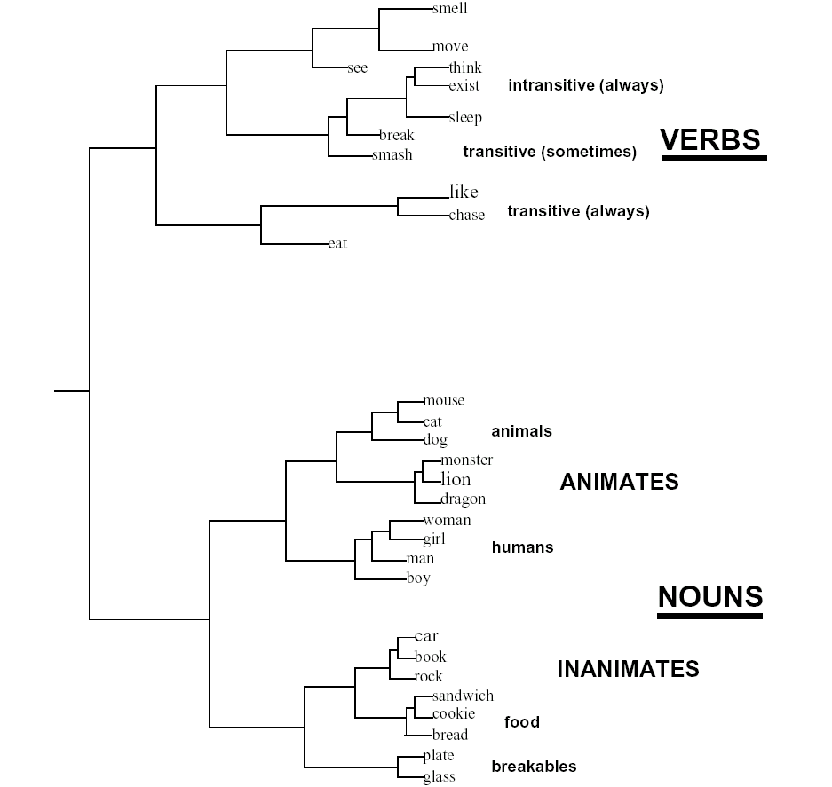
Internal representation of words

Slide 37
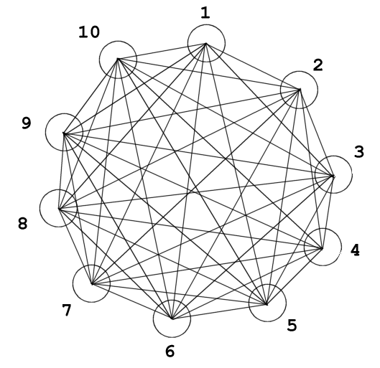
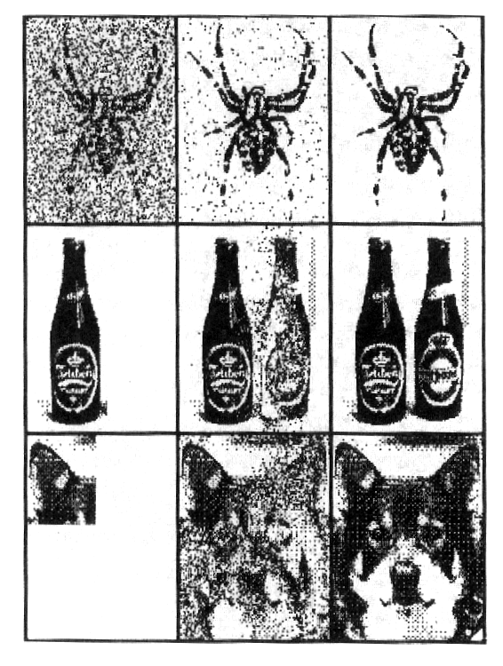
Hopfield Networks
Sub-type of recurrent neural nets
  Fully recurrent
  Weights are symmetric
  Nodes can only be on or off
  Random updating
Learning: Hebb rule (cells that fire together wire together)
  Biological equivalent to LTP and LTD
Can recall a memory, if presented with a
corrupt or incomplete version
→ auto-associative or
content-addressable memory

Slide 38
Task: store images with resolution of 20x20 pixels
→ Hopfield net with 400 nodes
Memorise:
  Present image
  Apply Hebb rule (cells that fire together, wire together)
    Increase weight between two nodes if both have same activity, otherwise decrease
  Go to 1
Recall:
  Present incomplete pattern
  Pick random node, update
  Go to 2 until settled
DEMO

Slide 39
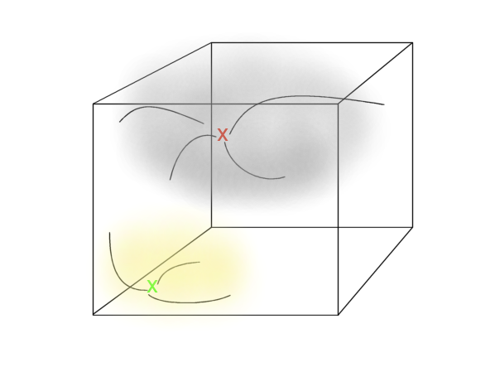
Memories are attractors in state space

Slide 40
Catastrophic forgetting
Problem: memorising new patterns corrupts the memory of older ones
  Old memories cannot be recalled, or spurious memories arise
Solution: allow Hopfield net to sleep

Slide 41
Two approaches (both using randomness):
  Unlearning (Hopfield, 1986)
    Recall old memories by random stimulation, but use an inverse Hebb rule
    ‘Makes room’ for new memories (basins of attraction shrink)
  Pseudorehearsal (Robins, 1995)
    While learning new memories, recall old memories by random stimulation
    Use standard Hebb rule on new and old memories
    Restructure memory
    Needs short-term + long term memory
    Mammals: hippocampus plays back new memories to neo-cortex, which is randomly stimulated at the same time

Slide 42
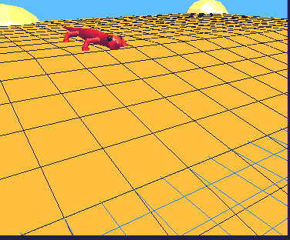
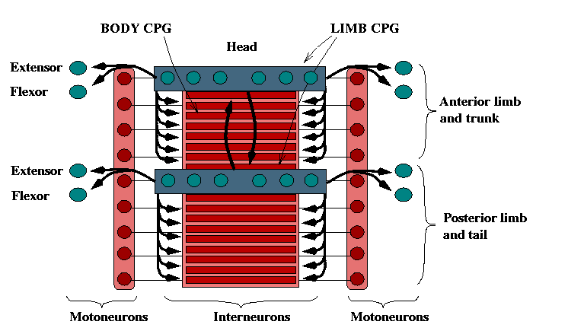
RNNs as Central Pattern Generators
CPGs: group of neurones creating rhythmic muscle activity for locomotion, heart-beat etc.
Identified in several invertebrates and vertebrates
Hard to study
→ Computer modelling
  E.g. lamprey swimming (Ijspeert et al., 1998)

Slide 43
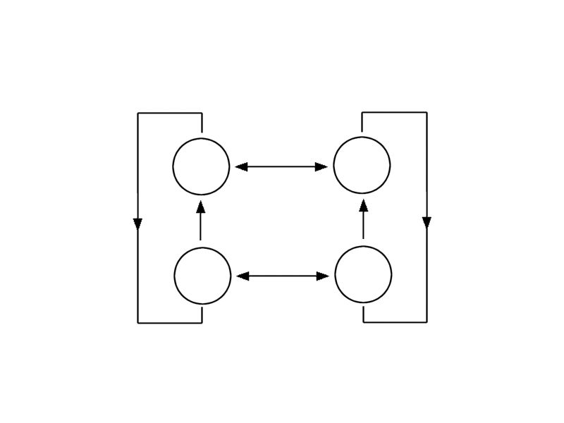
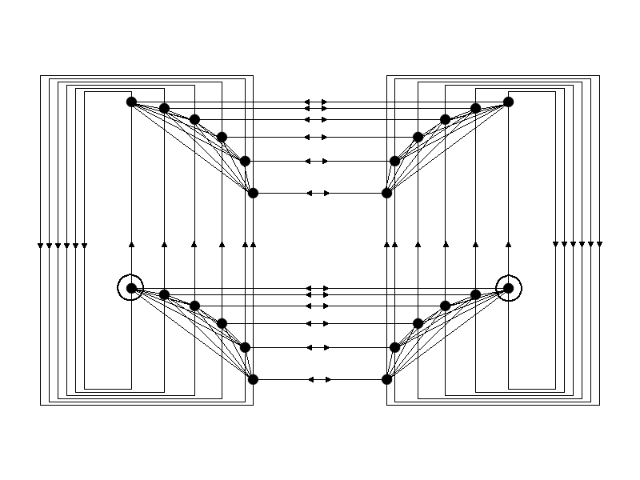
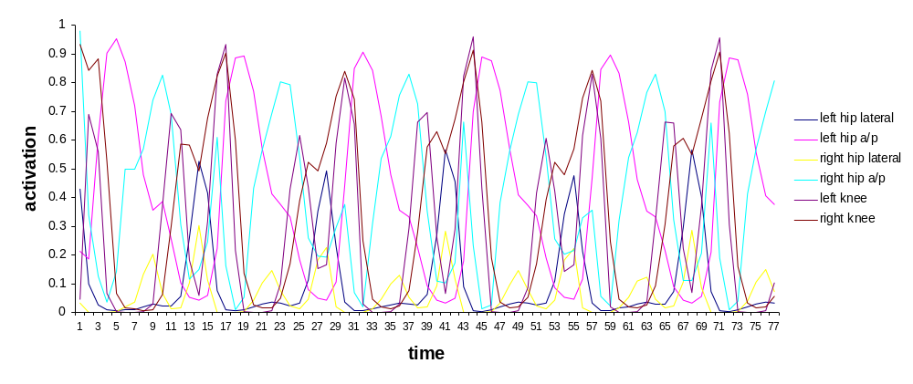
Evolution of Bipedal Walking (Reil & Husbands, 2001)

Slide 44
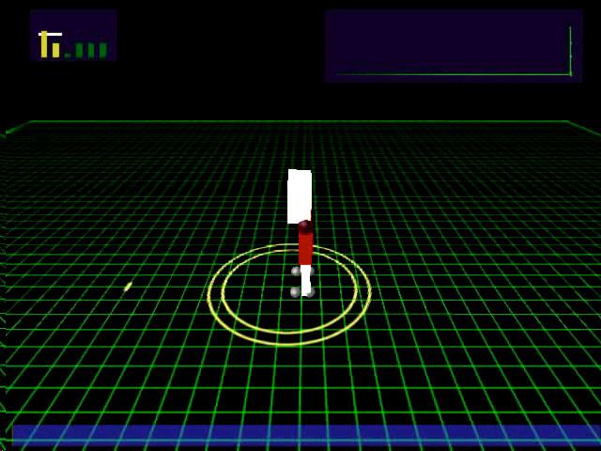

Slide 45
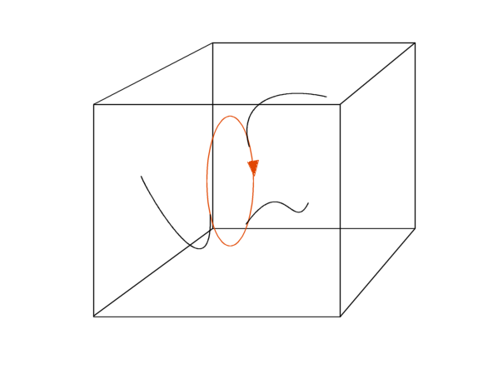
CPG cycles are cyclic attractors in state space

Slide 46
Recap – Neural Networks
Components – biological plausibility
  Neurone / node
  Synapse / weight
Feed forward networks
  Unidirectional flow of information
  Good at extracting patterns, generalisation and prediction
  Distributed representation of data
  Parallel processing of data
  Training: Backpropagation
  Not exact models, but good at demonstrating principles
Recurrent networks
  Multidirectional flow of information
  Memory / sense of time
  Complex temporal dynamics (e.g. CPGs)
  Various training methods (Hebbian, evolution)
  Often better biological models than FFNs

Slide 47
Online material: http://users.ox.ac.uk/~quee0818

